Slide 1
Introducing the New
Alpha Delta Kappa Website
LOGGING IN AND GETTING STARTED

Slide 2
SAME ADDRESS:
  GO TO:
  ALPHADELTAKAPPA.ORG

Slide 3
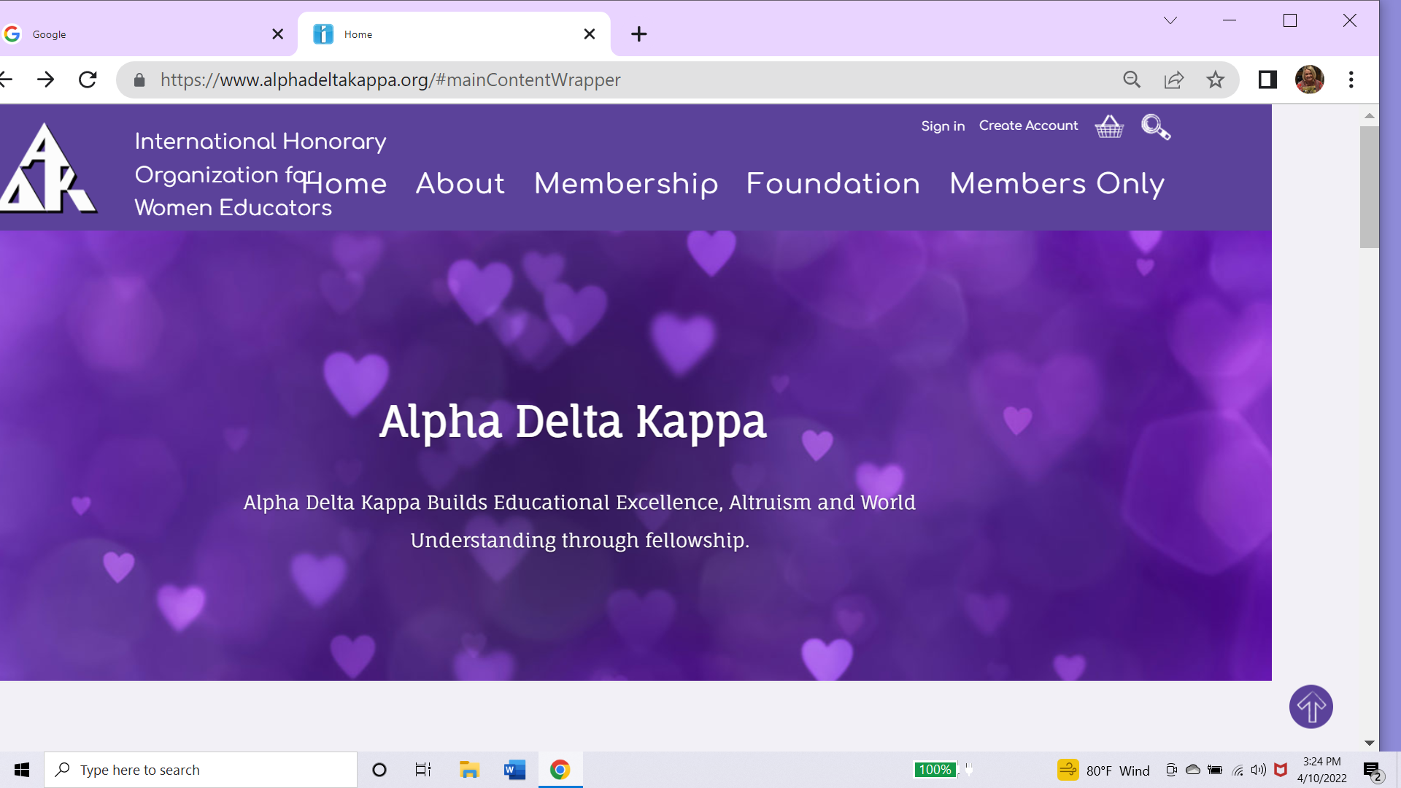
OPENING PAGE FIND ‘SIGN IN’

Slide 4
HOW TO LOG IN
USE YOUR OLD USER NAME
OR IF YOU HAVE FORGOTTEN THAT THEN USE YOUR LAST NAME AND YOUR ID NUMBER AS FOUND ON YOUR KAPPAN LABEL
YOU CAN HIT ‘FORGOT PASSWORD’ TO MAKE A NEW ONE
Or YOU CAN USE THIS PASSWORD THEN CHANGE IT ADK2022!
***Please don’t put this on social media or websites rather use newsletters and email lists to get the word out.

Slide 5
FURTHER HELP NEEDED
SOME WILL STILL HAVE PROBLEMS
AND NEED TO CALL HEADQUARTERS TO GET LOGGED IN.
SOME BROWERS HAVE TO BE CLEARED OF COOKIES AND HISTORY AND SOME LOCAL IT COMPANIES LIKE SBCGLOBAL ARE PROBLEMATIC.
BUT STAFF IS PREPARED TO HELP.
EMAIL HEADQUARTERS@ALPHADELTAKAPPA.ORG
OR CALL 1-800-247-2311

Slide 6
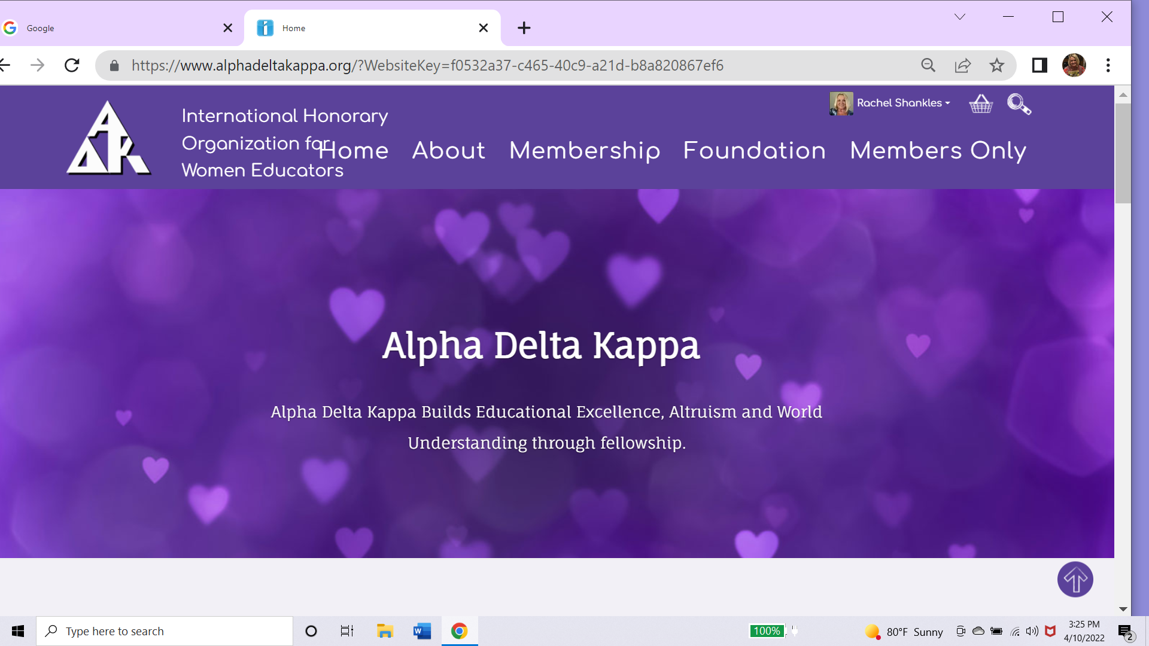
Where to start

Slide 7
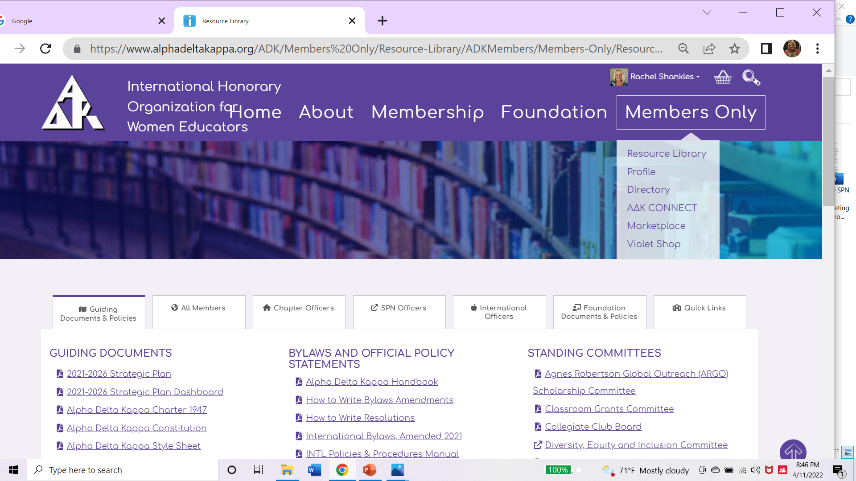
EXPLORE: MEMBERS ONLY

Slide 8
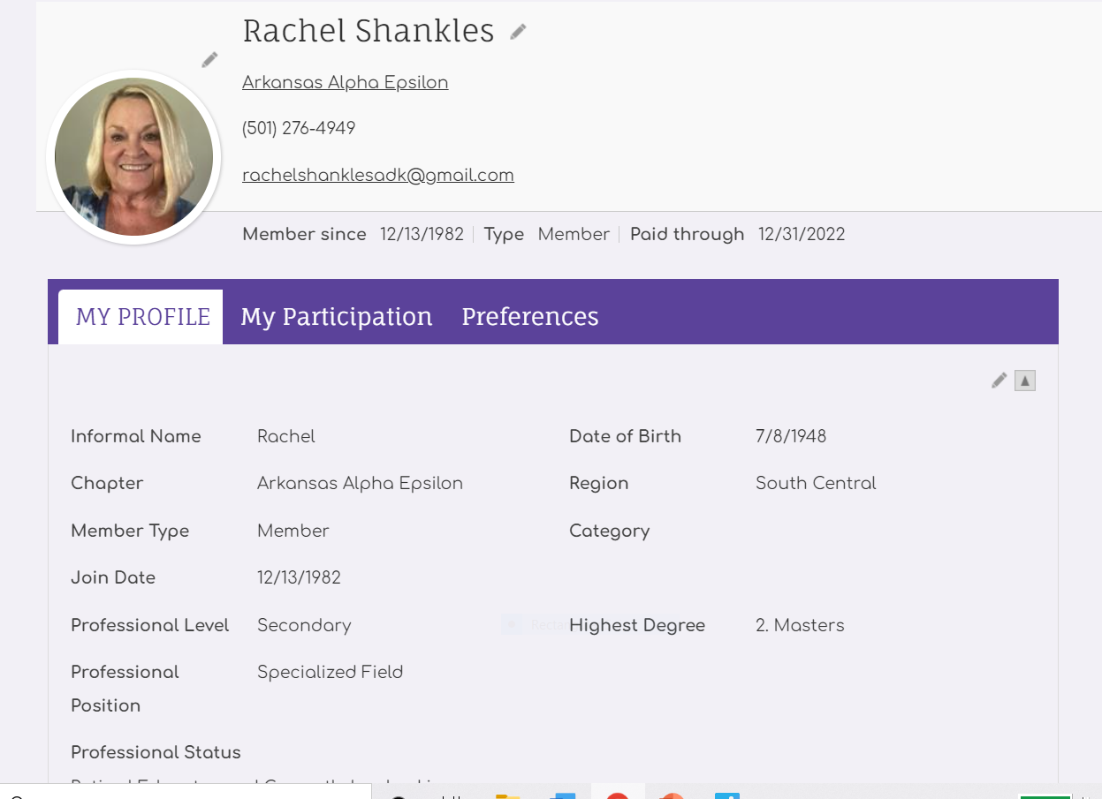
Profile: Pencil means EDIT

Slide 9
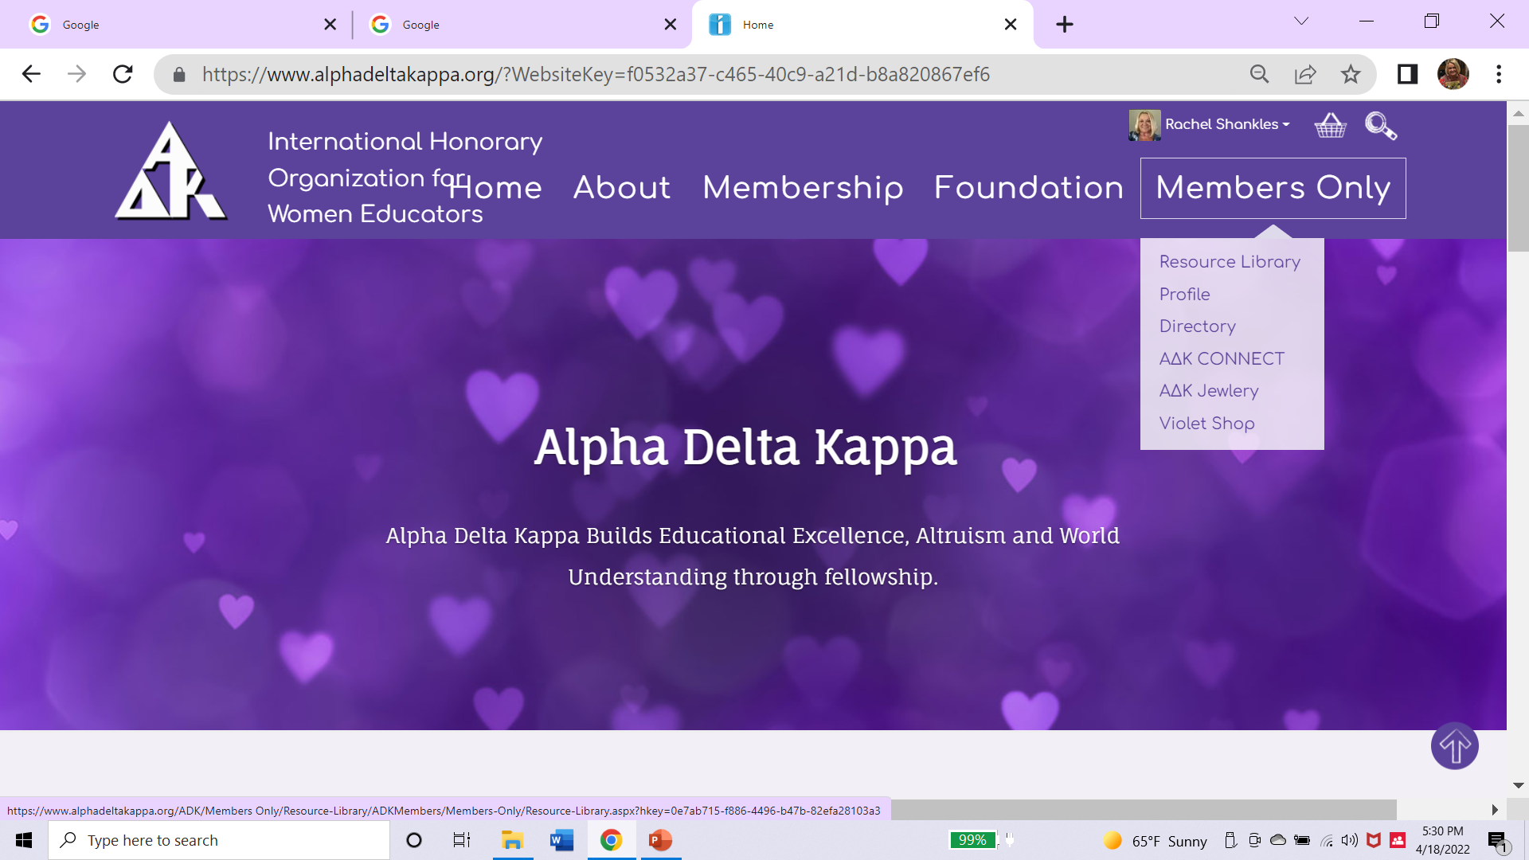
DIRECTORY

Slide 10
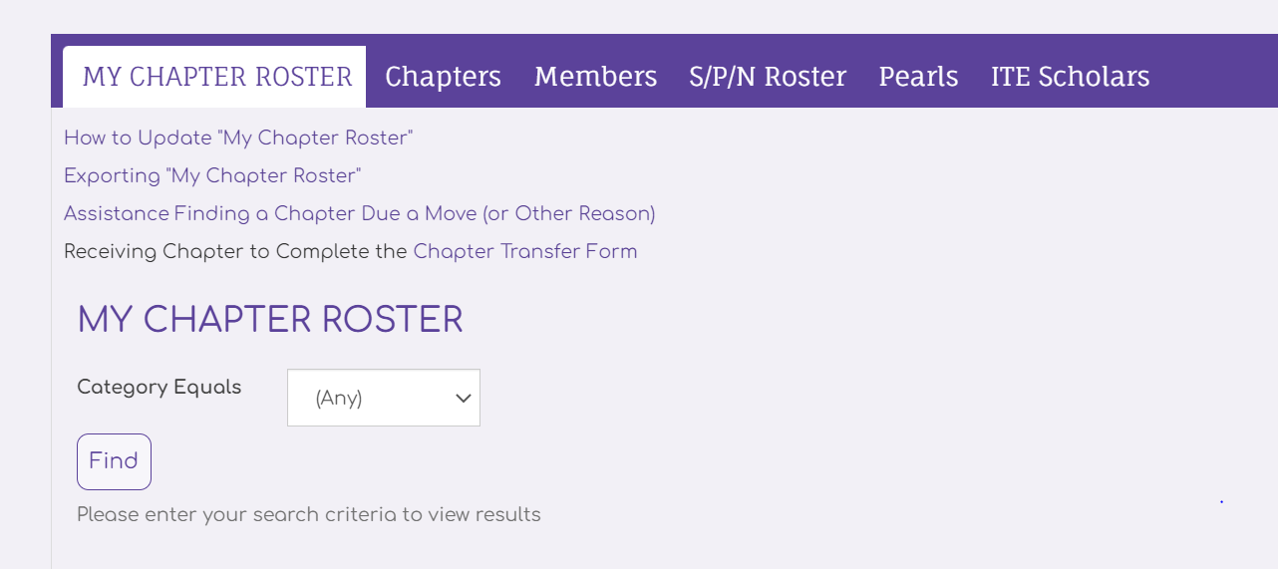
DIRECTORY: HIT ‘FIND’ FOR CHAPTER ROSTER
IN THE FUTURE THE CATEGORIES YOU CAN SEARCH WILL HAVE ALL THE OFFICES AND THINGS LIKE COMMITTEES AND OMEGA AND SUSTAINING AND MUCH MORE THAN WE HAD IN OLD DIRECTORY- BUT IT ALL ISN’T LOADED YET.

Slide 11
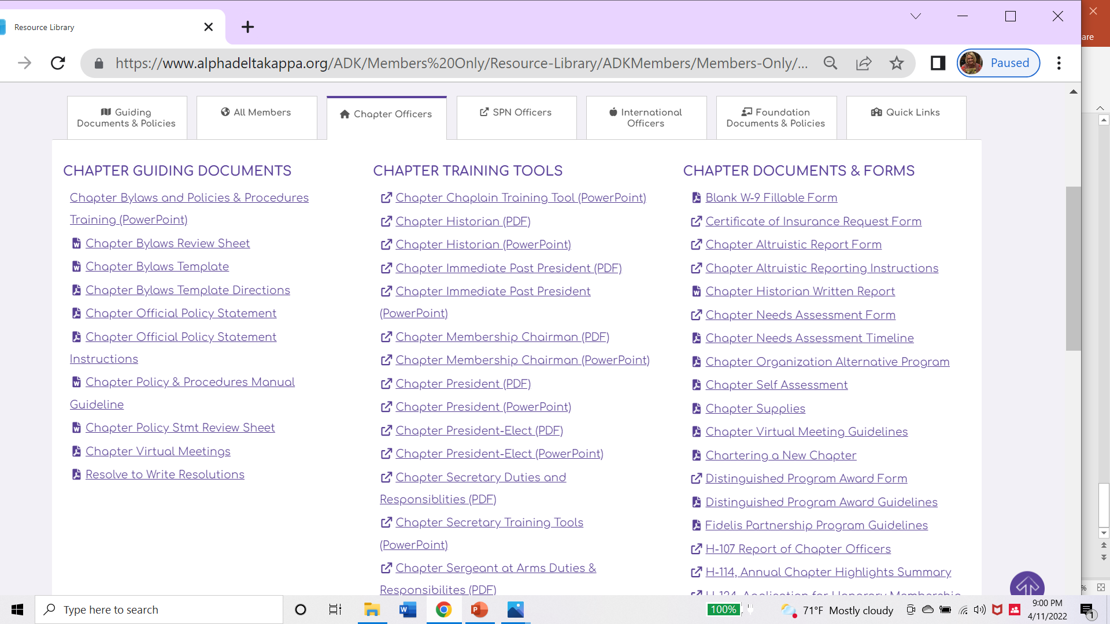
MEMBERS RESOURCES UNDER –CHAPTER OFFICERS

Slide 12
CONTACT
RACHEL SHANKLES, IVP SCR
RACHELSHANKLESADK@GMAIL.COM
501-276-4949

