Slide 1
Missouri ADK’s 2020-2022 Necrology Service

Slide 2
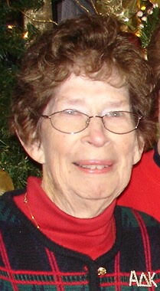
Ellen Weinhold
Beta Lambda
7/22/2020

Slide 3
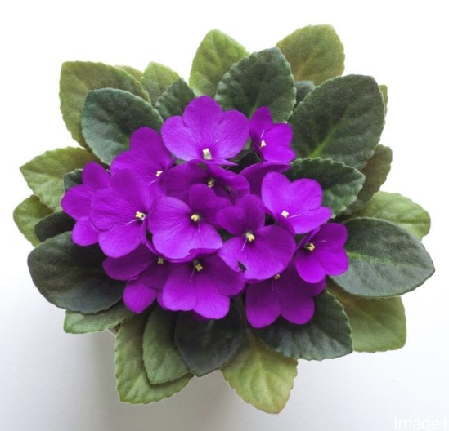
Carla Potter
Alpha Epsilon
10/10/2020

Slide 4
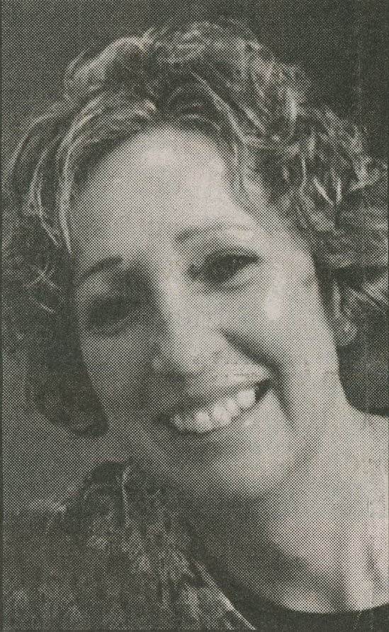
Amy Jo Hall
Gamma
11/15/2020

Slide 5
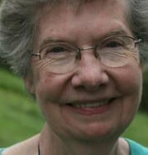
Ruth Sneed
Alpha Eta
12/2/2020

Slide 6
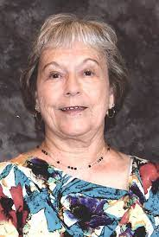
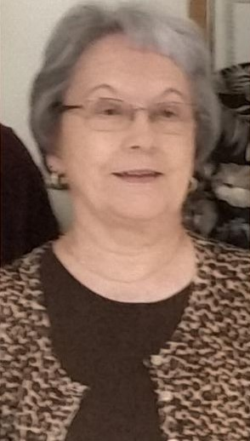
Jo Ann Herzberg
Gamma
1/6/2021

Slide 7
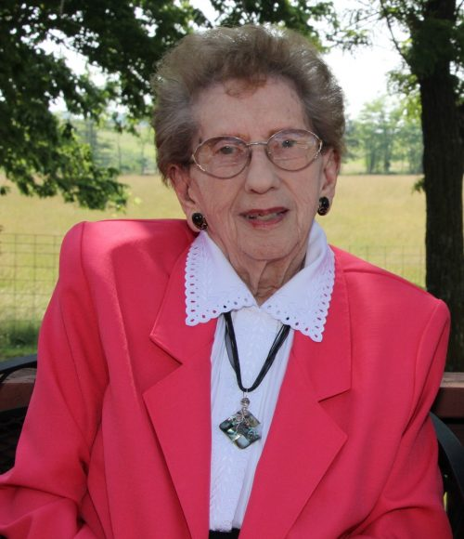
Ruth Owen
Beta Rho
1/12/2021

Slide 8
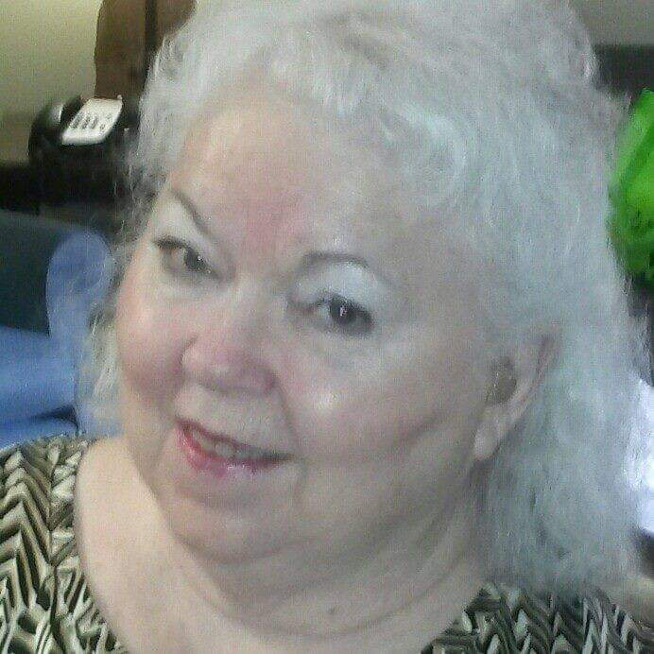
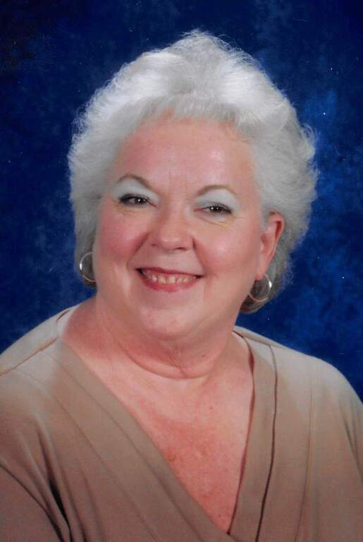
Phyllis Renshaw
Missouri State President
2004 - 2006
Omicron
2/3/2021

Slide 9
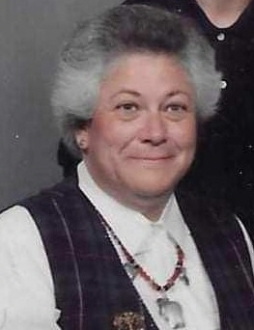
Cecile Ann Woodmansee
Missouri State President
2012 - 2014
Upsilon
3/21/2021

Slide 10
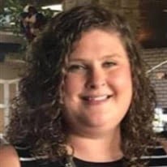
Laura Neislein
Beta Lambda
8/17/2021

Slide 11
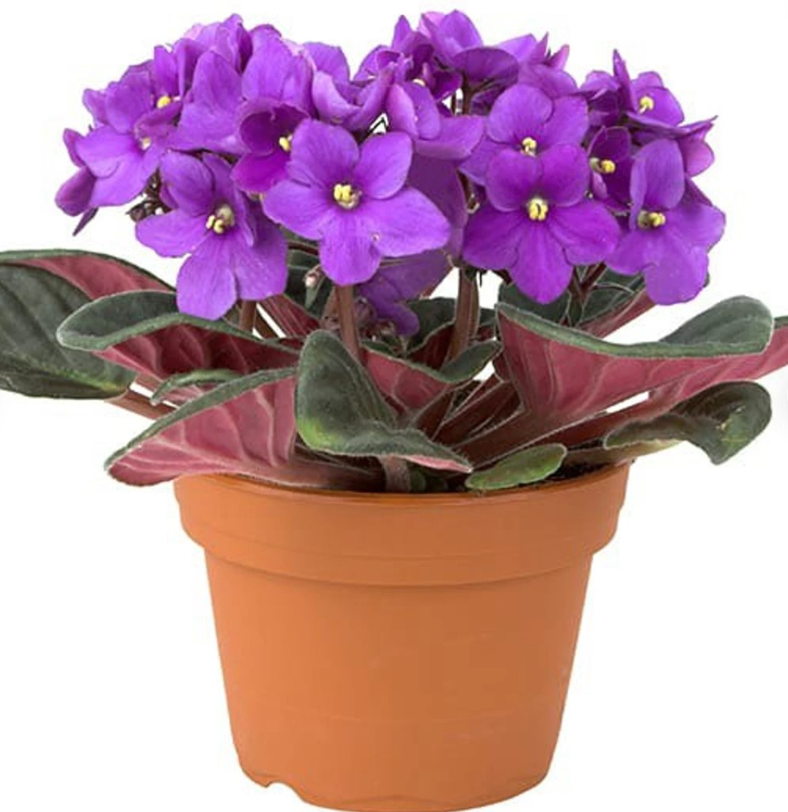
Dolora Jean Elam
Alpha Eta
8/22/2021

Slide 12
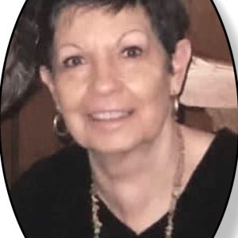
Charlene Pittman
Gamma
8/26/2021

Slide 13
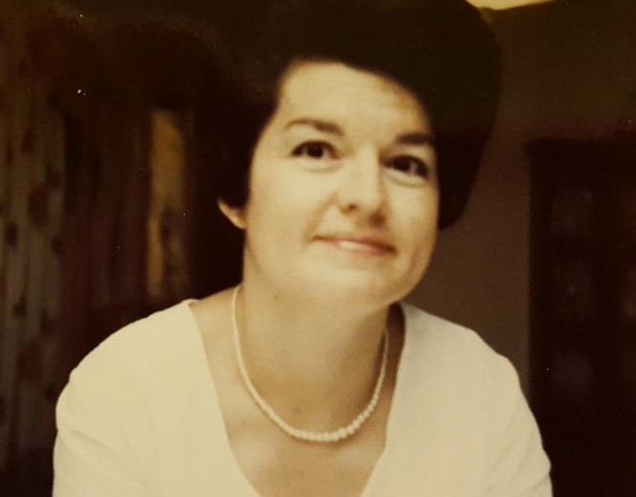
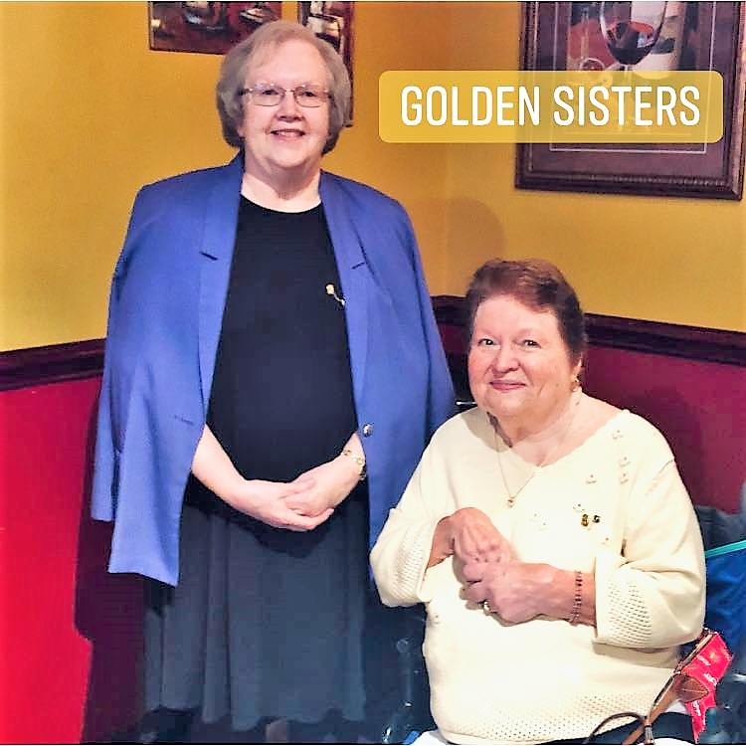
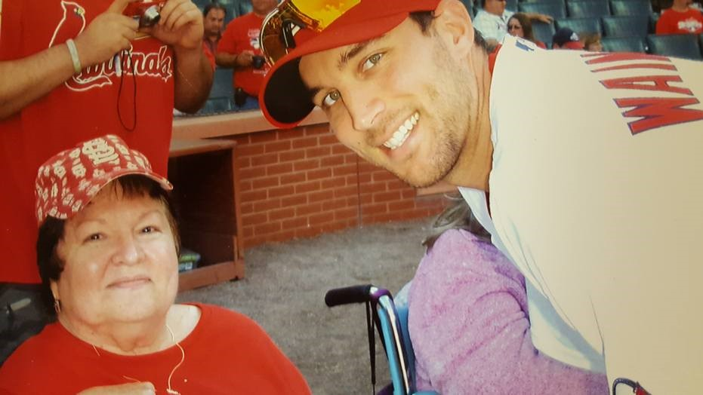
Donna Sellers
Beta Nu
12/13/2021

Slide 14
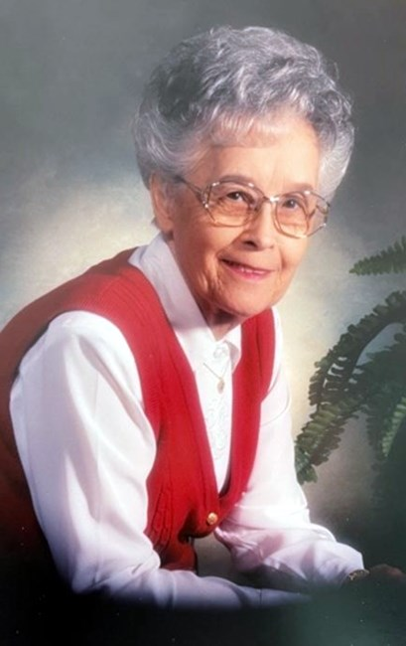
Leta Rose
Omicron
1/13/2022

